Slide 1
Amazon SageMaker Workshop

Slide 2
Agenda
Amazon SageMaker overview
Q & A
Setup for Workshop
Hands-on Workshop modules

Slide 3
Amazon SageMaker overview

Slide 4

Amazon SageMaker
A managed service that provides the quickest and easiest way for data scientists and developers to get
ML models from idea to production.

Slide 5
Components of Amazon SageMaker used in the Workshop
UX
Training
Hosting
Amazon’s fast, scalable algorithms
BYO script for ML frameworks
BYO algorithm
Hyperparameter optimization

Slide 6
Amazon SageMaker is Modular
Examples of adapting SageMaker to your workflow:
UX: Using a SageMaker notebook is convenient, but not necessary. Perhaps you prefer RStudio running on EC2 instead; that’s fine! Or scripts, or CLI . . . .
Training: SageMaker automates setting up and launching training clusters, but you can continue using your own training cluster.
You also can take a SageMaker-trained model elsewhere. . . .
Hosting: if you’re using your own training cluster, you can bring your model trained there into SageMaker hosting.

Slide 7
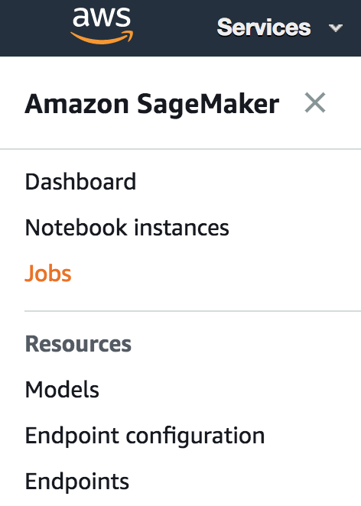

UX Choices
Use SageMaker‘s hosted Notebook Instances...
… or Apache Spark through EMR and the SageMaker Spark SDK...
... or SageMaker‘s Console for a point and click experience...
... or your own device (EC2, laptop, etc.)

Slide 8

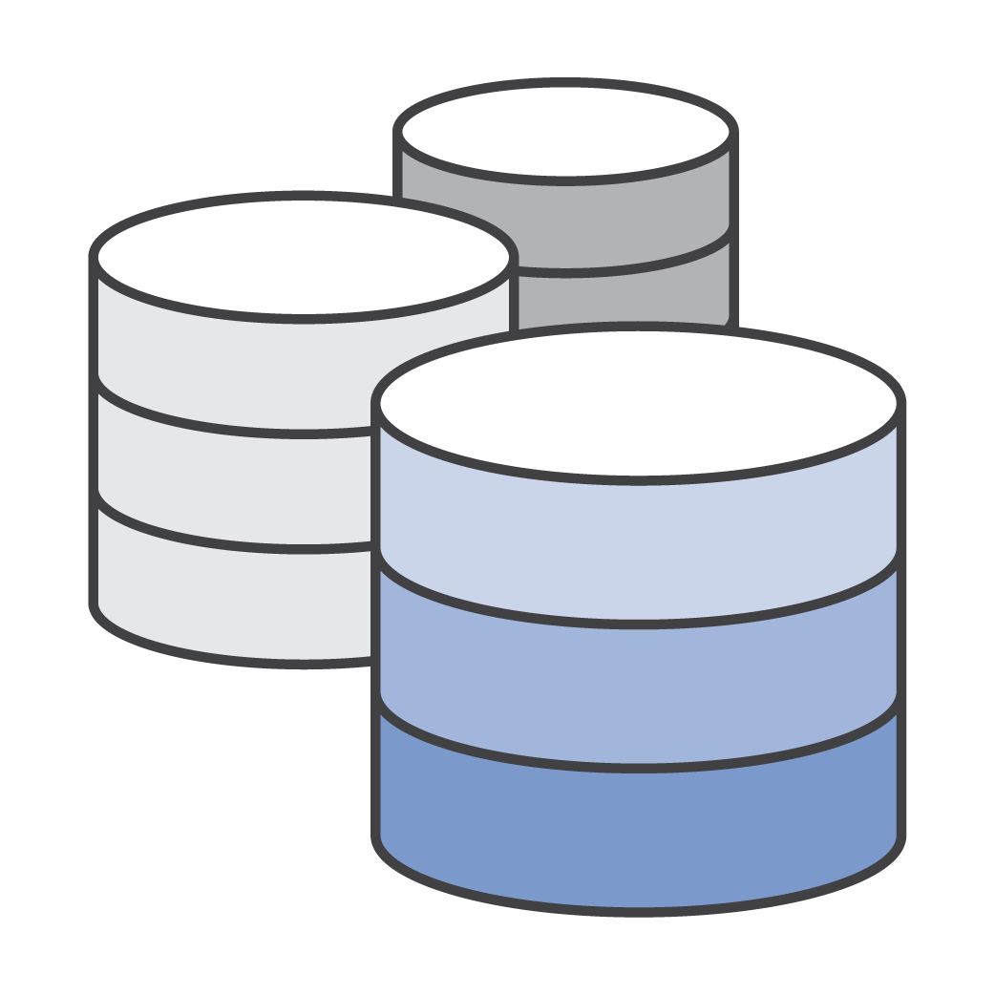
Training: Automated Hardware/Cluster Management
Zero setup
Support for streaming datasets + distributed compute
Docker / ECR under the hood (but you don’t need to touch it)
Deploy trained models locally, to SageMaker, or to edge devices such as DeepLens

Slide 9
Training: Built-in Algorithms for Web Scale
“General Purpose”:
Factorization Machines
K-Means
K-NN
Linear Learner
Object2Vec
PCA
XGBoost
NLP:
LDA
Neural Topic Model
Seq2Seq
BlazingText
Computer Vision:
Image Classification
Object Detection
Semantic Segmentation
Application Specific:
DeepAR
IP Insights
Random Cut Forest
Algorithms in blue font are neural net-based

Slide 10




Training: BYO Script Mode with Prebuilt Containers
Sample your data…
… explore and refine models in a Notebook Instance
Use the same code to train on the full dataset in a cluster of GPU instances…
… deploy to production

Slide 11



Training: Bring Your Own Algorithm (BYOA) using Docker
etc.
Amazon ECR
Pick your preferred technology...
... add algorithm code to a Docker container...
... publish image to ECR

Slide 12





Hosting: Automated Model Deployment & Autoscaling
One step deployment
Low latency, high throughput, and high reliability:
real time or batch transform
A/B testing
built-in
Use your own model

Slide 13



















There is more to SageMaker & the AWS ML Stack:
Vision
Speech
Language
Chatbots
Forecasting
Recommendations
AI SERVICES
REKOGNITION
IMAGE
REKOGNITION
VIDEO
TEXTRACT
POLLY
TRANSCRIBE
TRANSLATE
COMPREHEND
LEX
FORECAST
PERSONALIZE
AMAZON SAGEMAKER
ML SERVICES
BUILD
TRAIN
DEPLOY
Pre-built algorithms & notebooks
One-click model training & tuning
One-click deployment & hosting
Data labeling (GROUND TRUTH)
Optimization (NEO)
Algorithms & models (AWS MARKETPLACE
FOR MACHINE LEARNING)
Reinforcement learning
Frameworks
Interfaces
Infrastructure
ML FRAMEWORKS & INFRASTRUCTURE
EC2 P3 & P3N
EC2 C5
FPGAs
GREENGRASS
ELASTIC INFERENCE

Slide 14
Q&A

Slide 15
Getting Started on the Workshop

Slide 16
Setup for the Workshop
Access Amazon SageMaker from the AWS console.
(2) Review the prerequisites at:
https://github.com/awslabs/amazon-sagemaker-workshop
Go to the Introduction to SageMaker workshop, follow all steps through “Creating a Notebook Instance,” including creating a S3 bucket.

Slide 17
Lab Module Details
https://github.com/awslabs/amazon-sagemaker-workshop
We’ll cover 3 fundamental categories of ML in SageMaker. All labs/modules are independent and can be completed in any order, EXCEPT the Extra Credit module:
Structured Data Use Case – Videogame Sales: built-in algorithm.
Computer Vision Use Case – Image Classification: built-in algorithm.
NLP Use Case – Sentiment Analysis: BYO script defining your own neural net.
Extra Credit – Videogame Sales Using Scripts, the CLI and Console: while the above modules use Jupyter notebooks, this module shows other ways to use SageMaker.

Slide 18
Thank you!
https://github.com/awslabs/amazon-sagemaker-workshop

